Slide 1
4-BIT UP/DOWN COUNTER BCD SYNCHRONOUS COUNTER
LECTURE 10
Part 2

Slide 2
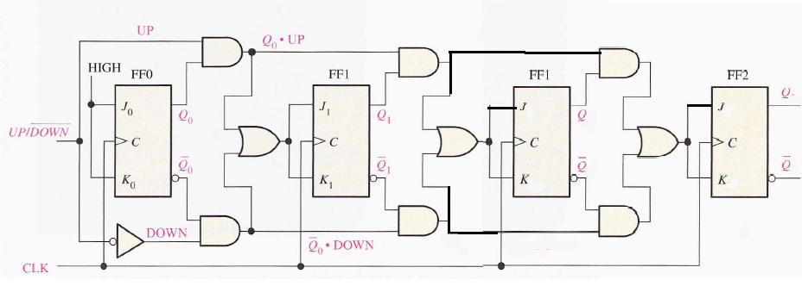
4-BIT UP/DOWN COUNTER

Slide 3
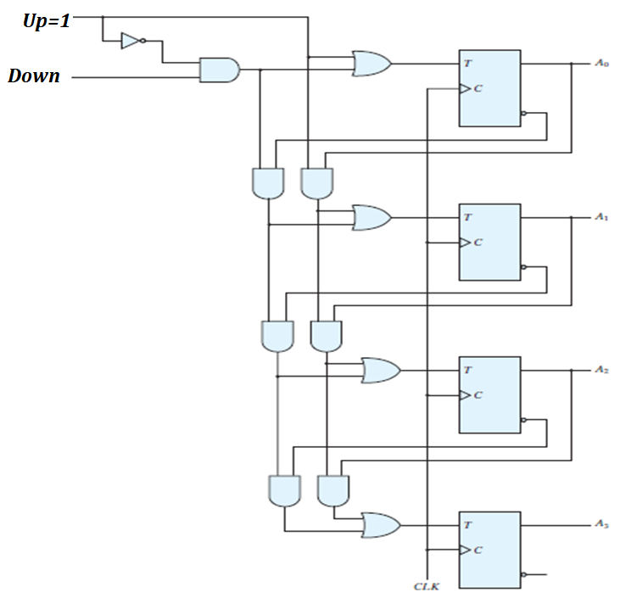
4-BIT UP/DOWN COUNTER

Slide 4
4-BIT UP/DOWN COUNTER
UP | DOWN | COMMENT
0 | 0
0 | 1
1 | 0
1 | 1

Slide 5
4-BIT UP/DOWN COUNTER

Slide 6
4-BIT UP/DOWN COUNTER
UP | DOWN | COMMENT
0 | 0
0 | 1
1 | X | UP

Slide 7
4-BIT UP/DOWN COUNTER
UP | DOWN | COMMENT
0 | 0
0 | 1
1 | X | UP

Slide 8
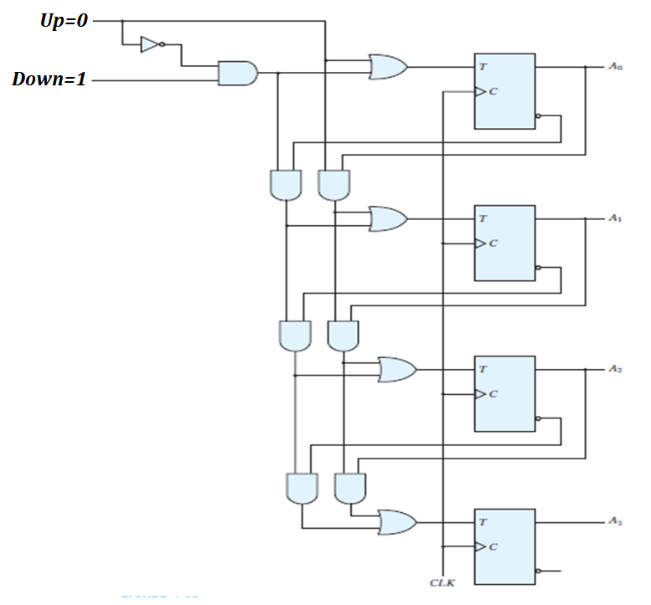
4-BIT UP/DOWN COUNTER

Slide 9
4-BIT UP/DOWN COUNTER
UP | DOWN | COMMENT
0 | 0
0 | 1 | DOWN
1 | X | UP

Slide 10
4-BIT UP/DOWN COUNTER
UP | DOWN | COMMENT
0 | 0
0 | 1 | DOWN
1 | X | UP

Slide 11
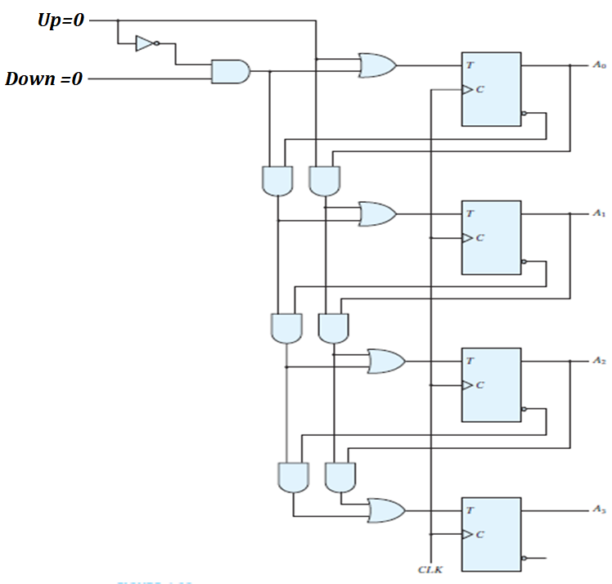
4-BIT UP/DOWN COUNTER

Slide 12
4-BIT UP/DOWN COUNTER
UP | DOWN | COMMENT
0 | 0 | NO CHANGE
0 | 1 | DOWN
1 | X | UP

Slide 13
THANKS

Slide 14
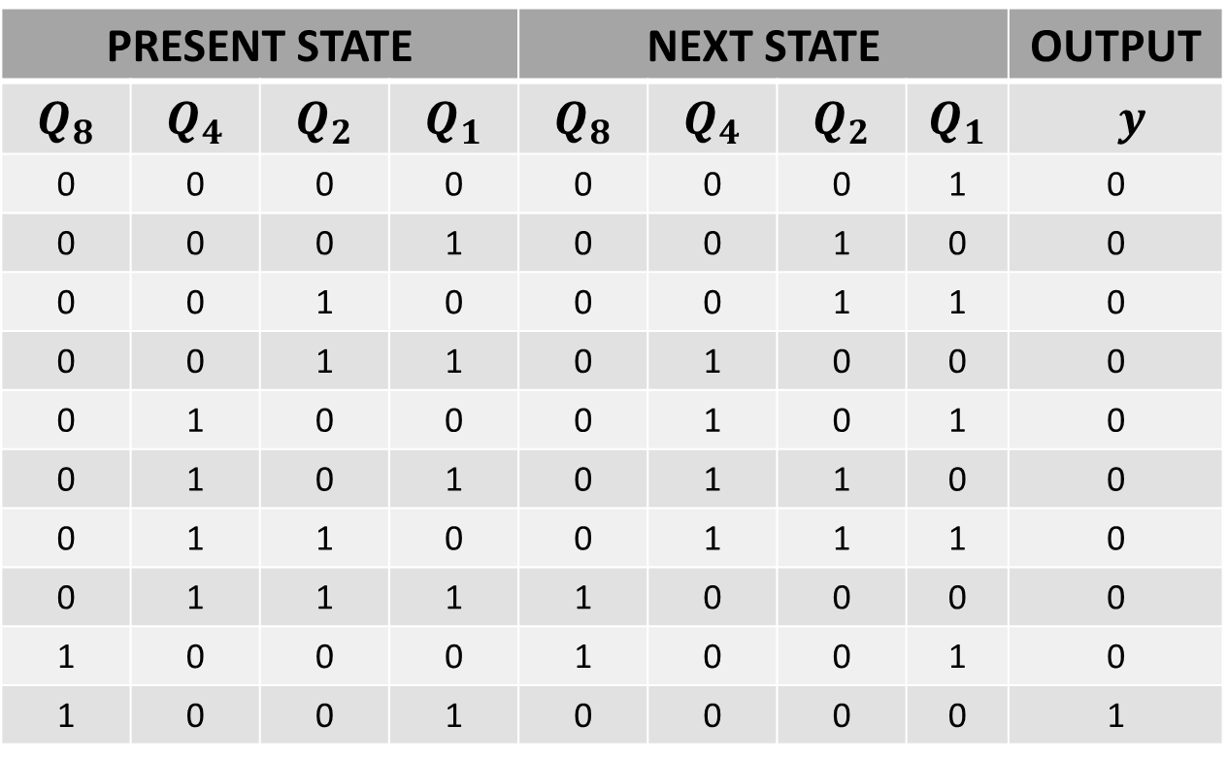
BCD COUNTER
PRESENT STATE |  |  |  | NEXT STATE |  |  |  | OUTPUT
$$Q_{8}$$ | $$Q_{4}$$ | $$Q_{2}$$ | $$Q_{1}$$ | $$Q_{8}$$ | $$Q_{4}$$ | $$Q_{2}$$ | $$Q_{1}$$ | $y$
0 | 0 | 0 | 0 | 0 | 0 | 0 | 1 | 0
0 | 0 | 0 | 1 | 0 | 0 | 1 | 0 | 0
0 | 0 | 1 | 0 | 0 | 0 | 1 | 1 | 0
0 | 0 | 1 | 1 | 0 | 1 | 0 | 0 | 0
0 | 1 | 0 | 0 | 0 | 1 | 0 | 1 | 0
0 | 1 | 0 | 1 | 0 | 1 | 1 | 0 | 0
0 | 1 | 1 | 0 | 0 | 1 | 1 | 1 | 0
0 | 1 | 1 | 1 | 1 | 0 | 0 | 0 | 0
1 | 0 | 0 | 0 | 1 | 0 | 0 | 1 | 0
1 | 0 | 0 | 1 | 0 | 0 | 0 | 0 | 1

Slide 15
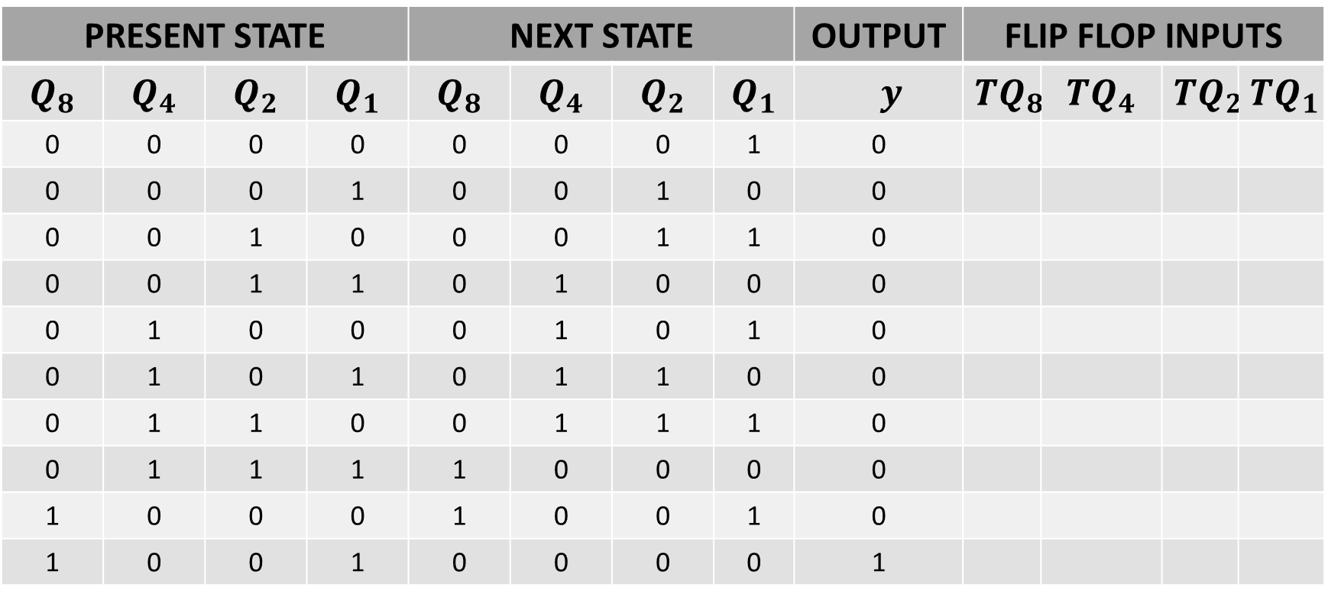
BCD COUNTER
PRESENT STATE |  |  |  | NEXT STATE |  |  |  | OUTPUT | FLIP FLOP INPUTS
$$Q_{8}$$ | $$Q_{4}$$ | $$Q_{2}$$ | $$Q_{1}$$ | $$Q_{8}$$ | $$Q_{4}$$ | $$Q_{2}$$ | $$Q_{1}$$ | $y$ | $${TQ}_{8}$$ | $${TQ}_{4}$$ | $${TQ}_{2}$$ | $${TQ}_{1}$$
0 | 0 | 0 | 0 | 0 | 0 | 0 | 1 | 0
0 | 0 | 0 | 1 | 0 | 0 | 1 | 0 | 0
0 | 0 | 1 | 0 | 0 | 0 | 1 | 1 | 0
0 | 0 | 1 | 1 | 0 | 1 | 0 | 0 | 0
0 | 1 | 0 | 0 | 0 | 1 | 0 | 1 | 0
0 | 1 | 0 | 1 | 0 | 1 | 1 | 0 | 0
0 | 1 | 1 | 0 | 0 | 1 | 1 | 1 | 0
0 | 1 | 1 | 1 | 1 | 0 | 0 | 0 | 0
1 | 0 | 0 | 0 | 1 | 0 | 0 | 1 | 0
1 | 0 | 0 | 1 | 0 | 0 | 0 | 0 | 1

Slide 16
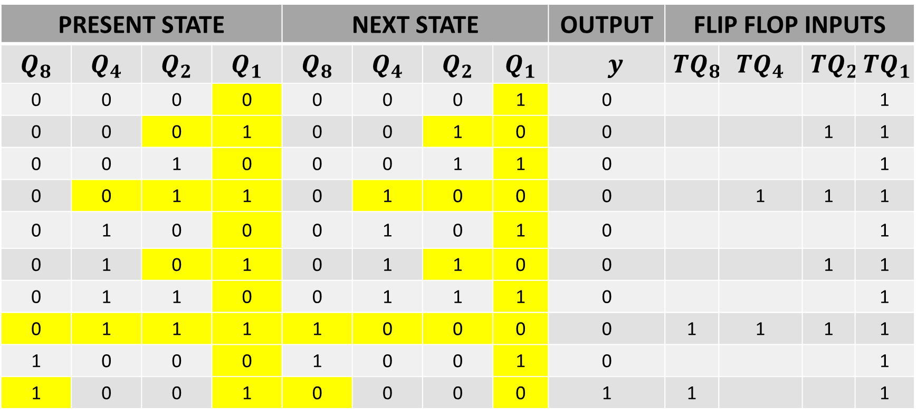
BCD COUNTER
PRESENT STATE |  |  |  | NEXT STATE |  |  |  | OUTPUT | FLIP FLOP INPUTS
$$Q_{8}$$ | $$Q_{4}$$ | $$Q_{2}$$ | $$Q_{1}$$ | $$Q_{8}$$ | $$Q_{4}$$ | $$Q_{2}$$ | $$Q_{1}$$ | $y$ | $${TQ}_{8}$$ | $${TQ}_{4}$$ | $${TQ}_{2}$$ | $${TQ}_{1}$$
0 | 0 | 0 | 0 | 0 | 0 | 0 | 1 | 0 |  |  |  | 1
0 | 0 | 0 | 1 | 0 | 0 | 1 | 0 | 0 |  |  | 1 | 1
0 | 0 | 1 | 0 | 0 | 0 | 1 | 1 | 0 |  |  |  | 1
0 | 0 | 1 | 1 | 0 | 1 | 0 | 0 | 0 |  | 1 | 1 | 1
0 | 1 | 0 | 0 | 0 | 1 | 0 | 1 | 0 |  |  |  | 1
0 | 1 | 0 | 1 | 0 | 1 | 1 | 0 | 0 |  |  | 1 | 1
0 | 1 | 1 | 0 | 0 | 1 | 1 | 1 | 0 |  |  |  | 1
0 | 1 | 1 | 1 | 1 | 0 | 0 | 0 | 0 | 1 | 1 | 1 | 1
1 | 0 | 0 | 0 | 1 | 0 | 0 | 1 | 0 |  |  |  | 1
1 | 0 | 0 | 1 | 0 | 0 | 0 | 0 | 1 | 1 |  |  | 1

Slide 17
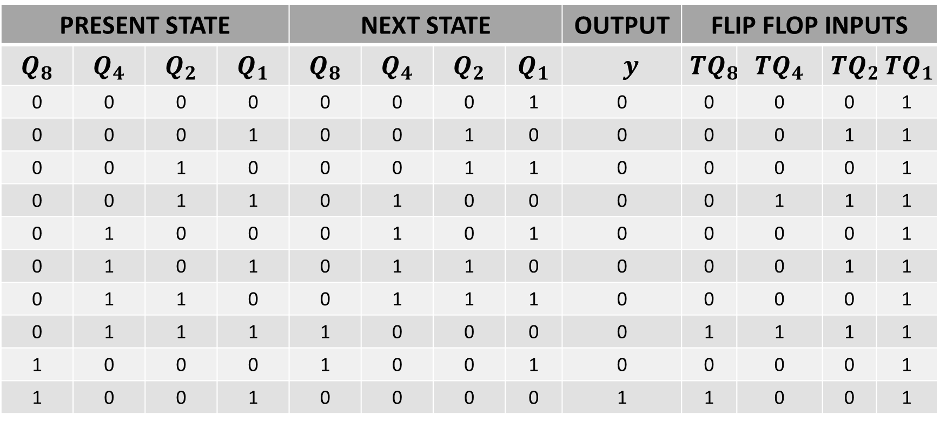
BCD COUNTER
PRESENT STATE |  |  |  | NEXT STATE |  |  |  | OUTPUT | FLIP FLOP INPUTS
$$Q_{8}$$ | $$Q_{4}$$ | $$Q_{2}$$ | $$Q_{1}$$ | $$Q_{8}$$ | $$Q_{4}$$ | $$Q_{2}$$ | $$Q_{1}$$ | $y$ | $${TQ}_{8}$$ | $${TQ}_{4}$$ | $${TQ}_{2}$$ | $${TQ}_{1}$$
0 | 0 | 0 | 0 | 0 | 0 | 0 | 1 | 0 | 0 | 0 | 0 | 1
0 | 0 | 0 | 1 | 0 | 0 | 1 | 0 | 0 | 0 | 0 | 1 | 1
0 | 0 | 1 | 0 | 0 | 0 | 1 | 1 | 0 | 0 | 0 | 0 | 1
0 | 0 | 1 | 1 | 0 | 1 | 0 | 0 | 0 | 0 | 1 | 1 | 1
0 | 1 | 0 | 0 | 0 | 1 | 0 | 1 | 0 | 0 | 0 | 0 | 1
0 | 1 | 0 | 1 | 0 | 1 | 1 | 0 | 0 | 0 | 0 | 1 | 1
0 | 1 | 1 | 0 | 0 | 1 | 1 | 1 | 0 | 0 | 0 | 0 | 1
0 | 1 | 1 | 1 | 1 | 0 | 0 | 0 | 0 | 1 | 1 | 1 | 1
1 | 0 | 0 | 0 | 1 | 0 | 0 | 1 | 0 | 0 | 0 | 0 | 1
1 | 0 | 0 | 1 | 0 | 0 | 0 | 0 | 1 | 1 | 0 | 0 | 1

Slide 18
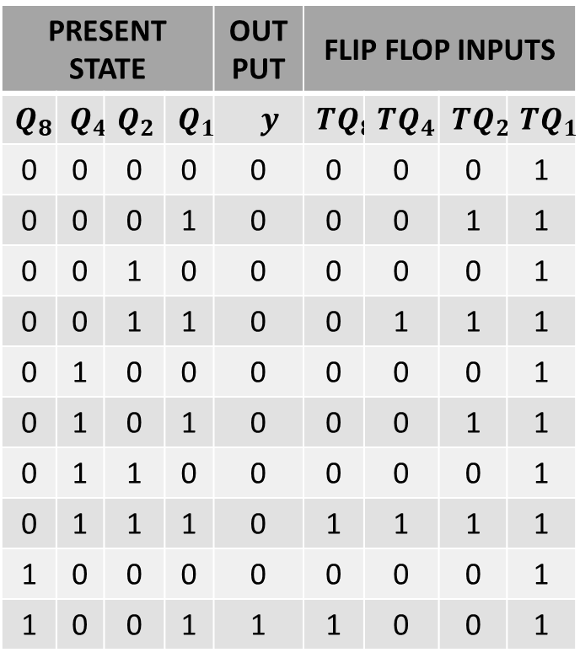
BCD COUNTER
PRESENT STATE |  |  |  | OUT PUT | FLIP FLOP INPUTS
$$Q_{8}$$ | $$Q_{4}$$ | $$Q_{2}$$ | $$Q_{1}$$ | $y$ | $${TQ}_{8}$$ | $${TQ}_{4}$$ | $${TQ}_{2}$$ | $${TQ}_{1}$$
0 | 0 | 0 | 0 | 0 | 0 | 0 | 0 | 1
0 | 0 | 0 | 1 | 0 | 0 | 0 | 1 | 1
0 | 0 | 1 | 0 | 0 | 0 | 0 | 0 | 1
0 | 0 | 1 | 1 | 0 | 0 | 1 | 1 | 1
0 | 1 | 0 | 0 | 0 | 0 | 0 | 0 | 1
0 | 1 | 0 | 1 | 0 | 0 | 0 | 1 | 1
0 | 1 | 1 | 0 | 0 | 0 | 0 | 0 | 1
0 | 1 | 1 | 1 | 0 | 1 | 1 | 1 | 1
1 | 0 | 0 | 0 | 0 | 0 | 0 | 0 | 1
1 | 0 | 0 | 1 | 1 | 1 | 0 | 0 | 1

Slide 19
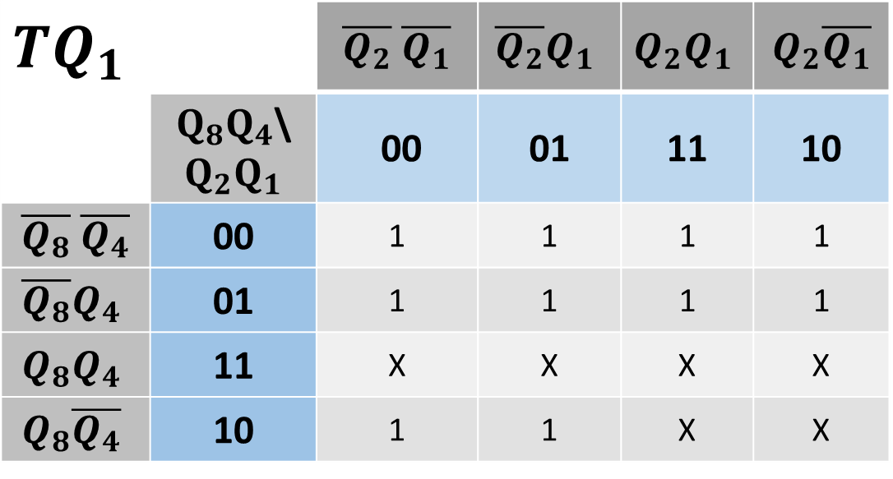
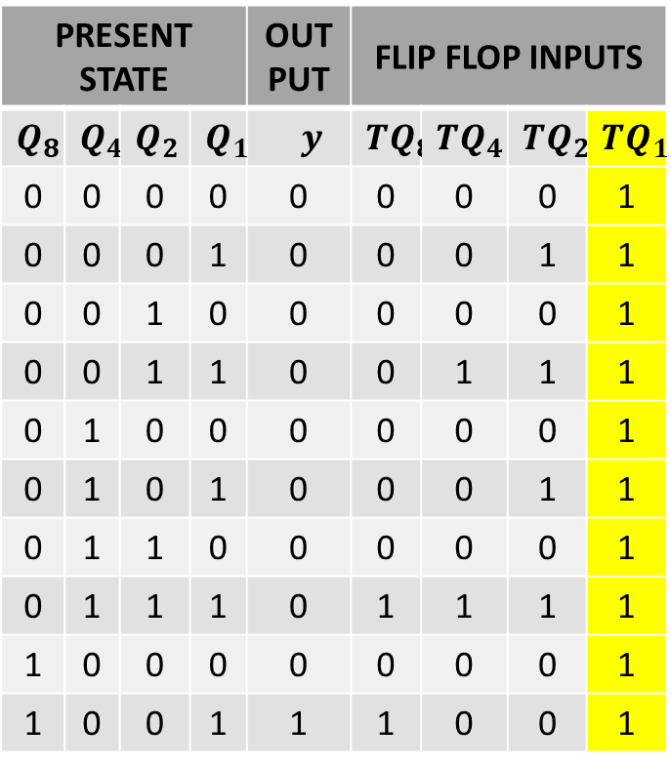
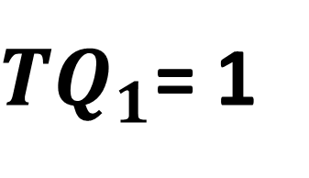
BCD COUNTER
PRESENT STATE |  |  |  | OUT PUT | FLIP FLOP INPUTS
$$Q_{8}$$ | $$Q_{4}$$ | $$Q_{2}$$ | $$Q_{1}$$ | $y$ | $${TQ}_{8}$$ | $${TQ}_{4}$$ | $${TQ}_{2}$$ | $${TQ}_{1}$$
0 | 0 | 0 | 0 | 0 | 0 | 0 | 0 | 1
0 | 0 | 0 | 1 | 0 | 0 | 0 | 1 | 1
0 | 0 | 1 | 0 | 0 | 0 | 0 | 0 | 1
0 | 0 | 1 | 1 | 0 | 0 | 1 | 1 | 1
0 | 1 | 0 | 0 | 0 | 0 | 0 | 0 | 1
0 | 1 | 0 | 1 | 0 | 0 | 0 | 1 | 1
0 | 1 | 1 | 0 | 0 | 0 | 0 | 0 | 1
0 | 1 | 1 | 1 | 0 | 1 | 1 | 1 | 1
1 | 0 | 0 | 0 | 0 | 0 | 0 | 0 | 1
1 | 0 | 0 | 1 | 1 | 1 | 0 | 0 | 1
$${TQ}_{1}$$ |  | $\overline{Q_{2}}$ $\overline{Q_{1}}$ | $$\overline{Q_{2}}Q_{1}$$ | $$Q_{2}Q_{1}$$ | $Q_{2}\overline{Q_{1}}$
 | $Q_{8}Q_{4}$\$Q_{2}Q_{1}$ | 00 | 01 | 11 | 10
$\overline{Q_{8}}$ $\overline{Q_{4}}$ | 00 | 1 | 1 | 1 | 1
$$\overline{Q_{8}}Q_{4}$$ | 01 | 1 | 1 | 1 | 1
$$Q_{8}Q_{4}$$ | 11 | X | X | X | X
$$Q_{8}\overline{Q_{4}}$$ | 10 | 1 | 1 | X | X
${TQ}_{1}$= 1

Slide 20

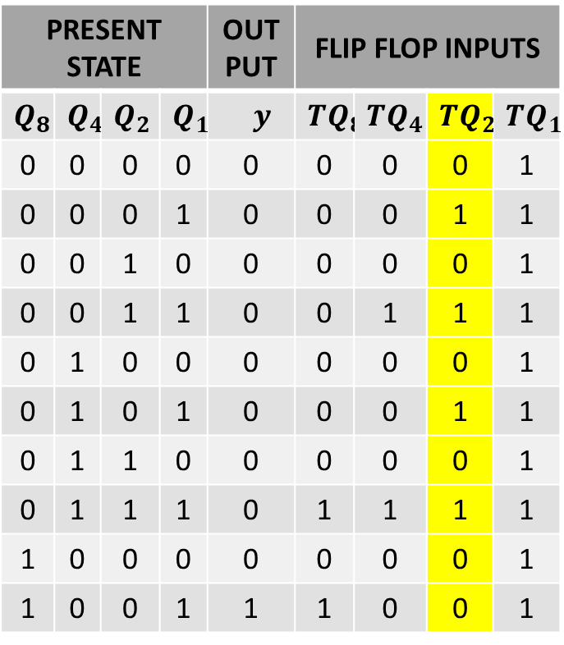
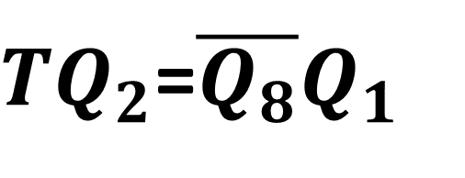
BCD COUNTER
PRESENT STATE |  |  |  | OUT PUT | FLIP FLOP INPUTS
$$Q_{8}$$ | $$Q_{4}$$ | $$Q_{2}$$ | $$Q_{1}$$ | $y$ | $${TQ}_{8}$$ | $${TQ}_{4}$$ | $${TQ}_{2}$$ | $${TQ}_{1}$$
0 | 0 | 0 | 0 | 0 | 0 | 0 | 0 | 1
0 | 0 | 0 | 1 | 0 | 0 | 0 | 1 | 1
0 | 0 | 1 | 0 | 0 | 0 | 0 | 0 | 1
0 | 0 | 1 | 1 | 0 | 0 | 1 | 1 | 1
0 | 1 | 0 | 0 | 0 | 0 | 0 | 0 | 1
0 | 1 | 0 | 1 | 0 | 0 | 0 | 1 | 1
0 | 1 | 1 | 0 | 0 | 0 | 0 | 0 | 1
0 | 1 | 1 | 1 | 0 | 1 | 1 | 1 | 1
1 | 0 | 0 | 0 | 0 | 0 | 0 | 0 | 1
1 | 0 | 0 | 1 | 1 | 1 | 0 | 0 | 1
$${TQ}_{2}$$ |  | $\overline{Q_{2}}$ $\overline{Q_{1}}$ | $$\overline{Q_{2}}Q_{1}$$ | $$Q_{2}Q_{1}$$ | $Q_{2}\overline{Q_{1}}$
 | $Q_{8}Q_{4}$\$Q_{2}Q_{1}$ | 00 | 01 | 11 | 10
$\overline{Q_{8}}$ $\overline{Q_{4}}$ | 00 | 0 | 1 | 1 | 0
$$\overline{Q_{8}}Q_{4}$$ | 01 | 0 | 1 | 1 | 0
$$Q_{8}Q_{4}$$ | 11 | X | X | X | X
$$Q_{8}\overline{Q_{4}}$$ | 10 | 0 | 0 | X | X
${TQ}_{2}$=$\overline{Q_{8}}Q_{1}$

Slide 21

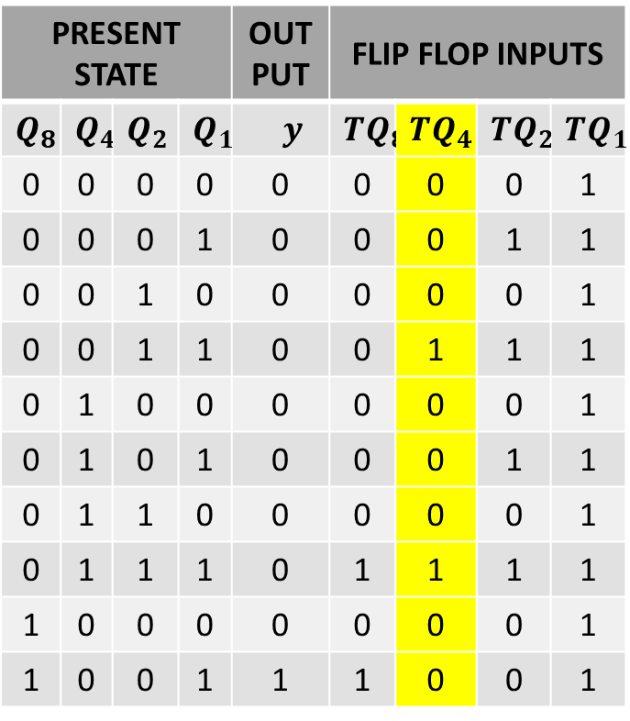
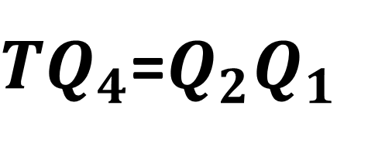
BCD COUNTER
PRESENT STATE |  |  |  | OUT PUT | FLIP FLOP INPUTS
$$Q_{8}$$ | $$Q_{4}$$ | $$Q_{2}$$ | $$Q_{1}$$ | $y$ | $${TQ}_{8}$$ | $${TQ}_{4}$$ | $${TQ}_{2}$$ | $${TQ}_{1}$$
0 | 0 | 0 | 0 | 0 | 0 | 0 | 0 | 1
0 | 0 | 0 | 1 | 0 | 0 | 0 | 1 | 1
0 | 0 | 1 | 0 | 0 | 0 | 0 | 0 | 1
0 | 0 | 1 | 1 | 0 | 0 | 1 | 1 | 1
0 | 1 | 0 | 0 | 0 | 0 | 0 | 0 | 1
0 | 1 | 0 | 1 | 0 | 0 | 0 | 1 | 1
0 | 1 | 1 | 0 | 0 | 0 | 0 | 0 | 1
0 | 1 | 1 | 1 | 0 | 1 | 1 | 1 | 1
1 | 0 | 0 | 0 | 0 | 0 | 0 | 0 | 1
1 | 0 | 0 | 1 | 1 | 1 | 0 | 0 | 1
$${TQ}_{4}$$ |  | $\overline{Q_{2}}$ $\overline{Q_{1}}$ | $$\overline{Q_{2}}Q_{1}$$ | $$Q_{2}Q_{1}$$ | $Q_{2}\overline{Q_{1}}$
 | $Q_{8}Q_{4}$\$Q_{2}Q_{1}$ | 00 | 01 | 11 | 10
$\overline{Q_{8}}$ $\overline{Q_{4}}$ | 00 | 0 | 0 | 1 | 0
$$\overline{Q_{8}}Q_{4}$$ | 01 | 0 | 0 | 1 | 0
$$Q_{8}Q_{4}$$ | 11 | X | X | X | X
$$Q_{8}\overline{Q_{4}}$$ | 10 | 0 | 0 | X | X
${TQ}_{4}$=$Q_{2}Q_{1}$

Slide 22
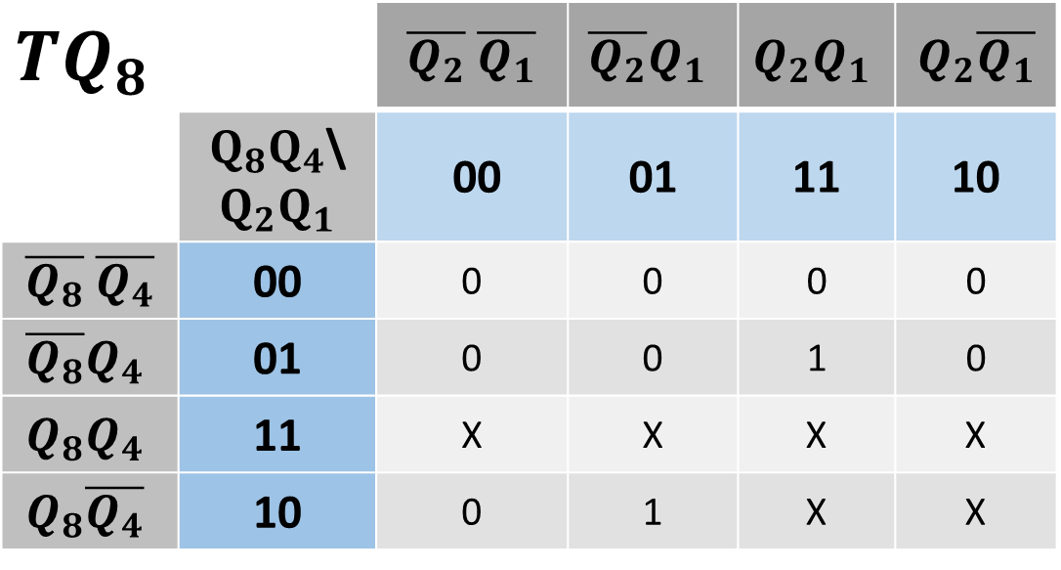
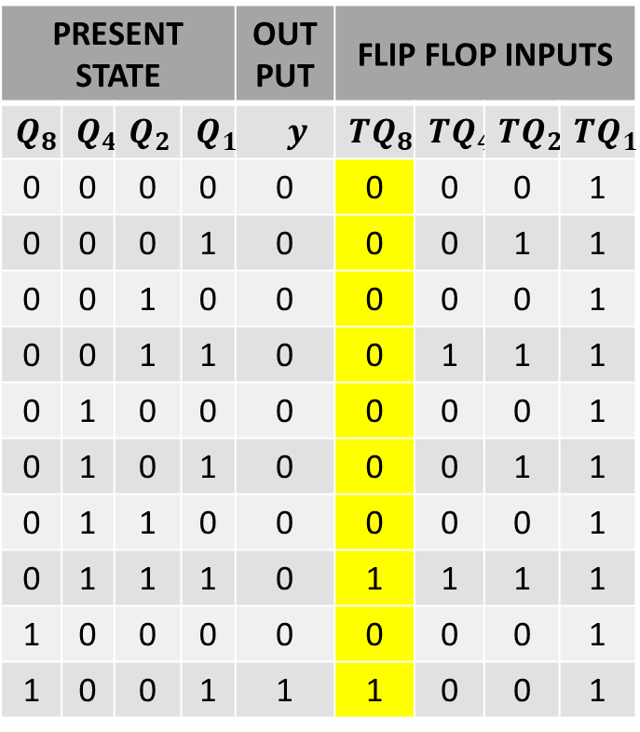
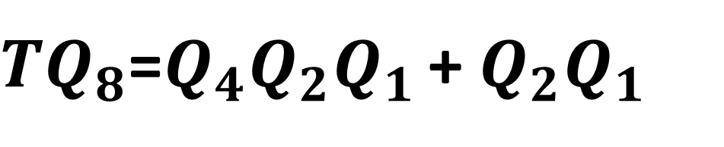
BCD COUNTER
PRESENT STATE |  |  |  | OUT PUT | FLIP FLOP INPUTS
$$Q_{8}$$ | $$Q_{4}$$ | $$Q_{2}$$ | $$Q_{1}$$ | $y$ | $${TQ}_{8}$$ | $${TQ}_{4}$$ | $${TQ}_{2}$$ | $${TQ}_{1}$$
0 | 0 | 0 | 0 | 0 | 0 | 0 | 0 | 1
0 | 0 | 0 | 1 | 0 | 0 | 0 | 1 | 1
0 | 0 | 1 | 0 | 0 | 0 | 0 | 0 | 1
0 | 0 | 1 | 1 | 0 | 0 | 1 | 1 | 1
0 | 1 | 0 | 0 | 0 | 0 | 0 | 0 | 1
0 | 1 | 0 | 1 | 0 | 0 | 0 | 1 | 1
0 | 1 | 1 | 0 | 0 | 0 | 0 | 0 | 1
0 | 1 | 1 | 1 | 0 | 1 | 1 | 1 | 1
1 | 0 | 0 | 0 | 0 | 0 | 0 | 0 | 1
1 | 0 | 0 | 1 | 1 | 1 | 0 | 0 | 1
$${TQ}_{8}$$ |  | $\overline{Q_{2}}$ $\overline{Q_{1}}$ | $$\overline{Q_{2}}Q_{1}$$ | $$Q_{2}Q_{1}$$ | $Q_{2}\overline{Q_{1}}$
 | $Q_{8}Q_{4}$\$Q_{2}Q_{1}$ | 00 | 01 | 11 | 10
$\overline{Q_{8}}$ $\overline{Q_{4}}$ | 00 | 0 | 0 | 0 | 0
$$\overline{Q_{8}}Q_{4}$$ | 01 | 0 | 0 | 1 | 0
$$Q_{8}Q_{4}$$ | 11 | X | X | X | X
$$Q_{8}\overline{Q_{4}}$$ | 10 | 0 | 1 | X | X
${TQ}_{8}$=$Q_{4}Q_{2}Q_{1 }$+ $Q_{2}Q_{1}$

Slide 23
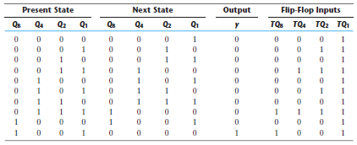
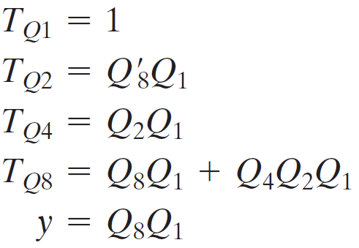
BCD COUNTER

Slide 24
THANKS

